Slide 1
SCM 651: Business Analytics
Week 10

Slide 2
Agenda
*** Course evaluations due Tuesday June 14 ***
*** Final Exam Wednesday June 15 ***
*** Peer review due Wednesday June 15 ***
Homework #4
Review of hands-on exercises
Final Exam topics
Group discussion of articles
Business Analytics: Transforming the Role of Management Accountants
Elevating Data, Analytics to the C-Suite
Course Feedback

Slide 3
Homework #4
Logit and probit analysis (see week 9)
Moderating effects (week 7)
Final logit & probit models with interaction effects (moderating effects), prediction of outcome, sensitivity analysis
Neural network analysis
Neural network prediction model and sensitivity analysis (new material in handout in week 9)

Slide 4
Week 10 - Review
Dashboards can:
Import diverse types of data from spreadsheets, text files, databases, PDFs, etc.
Build relationships between imported tables
Perform calculations to create new values
Refresh data to retrieve a new copy of the information

Slide 5
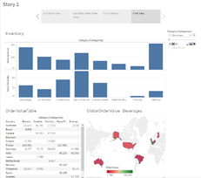
Week 10 - Review
Tableau can:
Import data from a variety of file types
Create pivot tables
Generate a variety of graph types
Build worksheets, dashboards, and stories

Slide 6
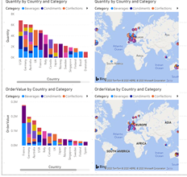
Week 10 – Review
MS Power BI can:
Import data from a variety of file types
Create pivot tables
Generate a variety of graph types
Build worksheets & dashboards

Slide 7
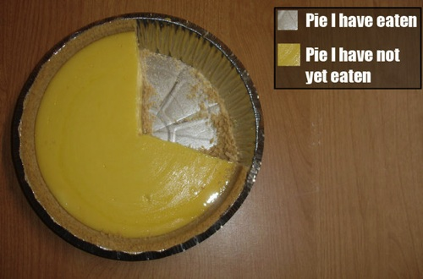
Tableau dashboards: Pie charts
My favorite pie chart:

Slide 8
A business analytics student was taking a test …
The student started taking the test, flipping a coin, then writing down an answer
After 30 minutes, all other students had finished and left the room
After 60 minutes, the professor asked the student, still flipping a coin, if he was having difficulty
The student said
No, I finished 30 minutes ago,
I’m just checking my answers

Slide 9
Article #1: Business Analytics: Transforming the Role of Management Accountants
Article #1: Business Analytics: Transforming the Role of Management Accountants
What are some external and internal data sources for accountants? (page 3)
What are four challenges for accountants using analytics? (page 4)
What are five areas for leveraging analytics in accounting? (page 4)

Slide 10
Article #1: Business Analytics: Transforming the Role of Management Accountants
Article #1: Business Analytics: Transforming the Role of Management Accountants
What are some external and internal data sources for accountants? (page 3)
Spreadsheets, CSV files, Access files, SQL queries, ERP data, Google Analytics, Salesforce data, sensors, emails, videos, tweets
What are four challenges for accountants using analytics? (page 4)
Awareness: understanding the value of business analytics to the organization
Interoperability: linking structured and unstructured data
Security: maintaining data integrity, minimizing the risk to the company’s reputation, avoiding lawsuits
Analysis quality: minimize garbage-in, garbage-out
What are five areas for leveraging analytics in accounting? (page 4)
Franchise sales analysis
Accounts receivable and credit analysis
Accounts payable and payment monitoring
Mergers and acquisitions
Forensic accounting

Slide 11
Article #2: Elevating Data, Analytics to the C-Suite
Article #2: Elevating Data, Analytics to the C-Suite
What are the steps to elevate a department using analytics? (page 5)
How should you address non-perfect data? (page 5)
Should analytics teams be centralized or decentralized? (page 6)

Slide 12
Article #2: Elevating Data Analytics to the C-Suite
Article #2: Elevating Data, Analytics to the C-Suite
What are the steps to elevate a department using analytics? (page 5)
Data first
Reporting
Analytics
Quantitative and predicting modeling
How should you address non-perfect data? (page 5)
Don’t wait for 100% perfect data
Identify and explain data limitations as part of analysis
Should analytics teams be centralized or decentralized? (page 6)
Centralized for small organizations
Decentralized, closer to the business units, for large organizations

